Slide 1
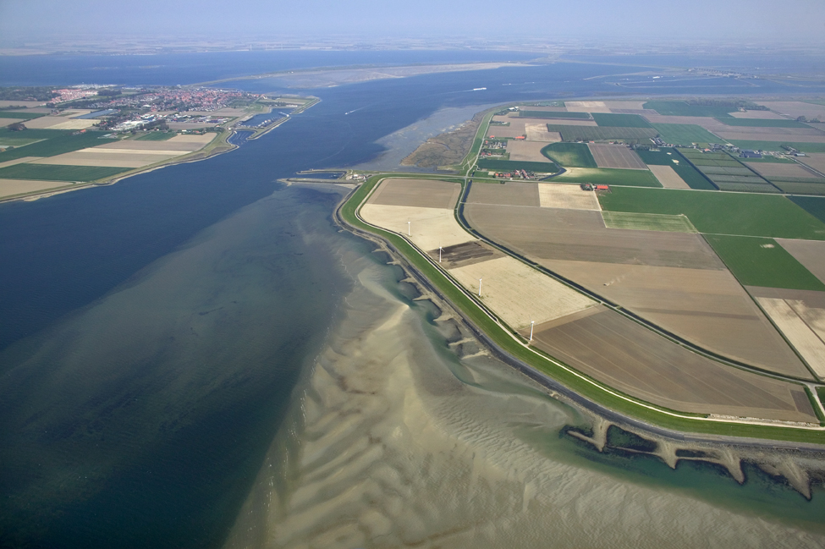


Delft-FEWS
Advanced Configuration Course

Slide 2


FEWS External Modules/Models

Slide 3
Generic workflow to run a model in FEWS
Data import
Pre-processing (transformations)
Running any external module
Pre-adapter
Run model
Post-adapter
Post-processing
Visualisation

Slide 4
General Adapter -Concepts
Delft-FEWS
published interface
General Adapter
input data
(pi xml)
output data
(pi xml)
Pre
Module Adapter
Post
module
input data
module
output data
Module

Slide 5
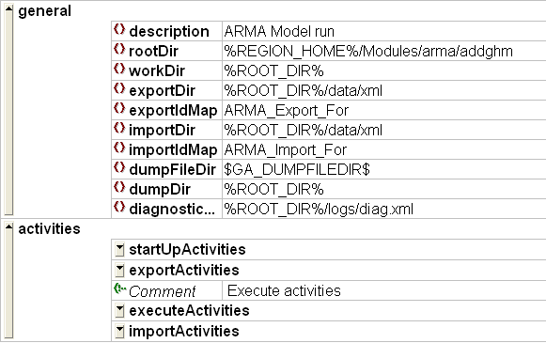
General Adapter – Configuration
DELFT-FEWS reserved keyword
From global.properties
General Adapter keywords

Slide 6
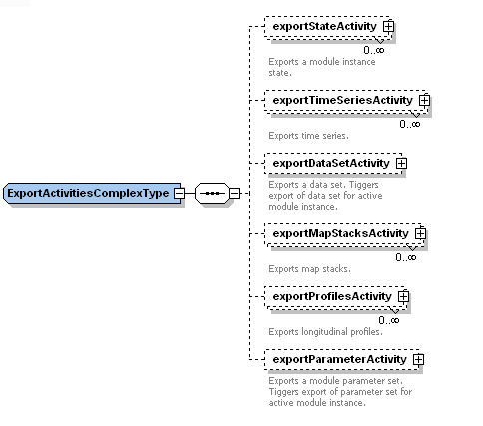
General Adapter – Export Activities
Export Activities
Time Series – scalar
Time Series – grids (map stacks)
Time Series – profile
States
ModuleDataSet
ModuleParameters

Slide 7
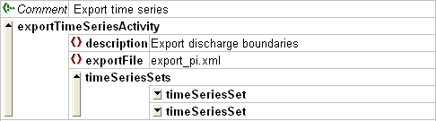
Export Activities – Scalar/longitudinal time Series
Exports time series from database to a PI-XML file
Assign File name to export data to
Assign Time Series Sets to export
Written to exportDir
LocationID’s & ParameterID’s will be translated on export (as indicated in IdMapping)

Slide 8
Export activities - grid time series
Same principle as exporting scalar time series
Supported grid file formats
ASC: ArcView/ARC-INFO grid interchange file
Time Series as map stack
PCR: PCRaster file format
Time Series as map stack
BIL: USGS standard grid format
Time series in one file

Slide 9

Export Activities – Module parameters
DELFT-FEWS administers module parameters
Exports to external module as PI-XML file
Held in Config\ModuleParFiles

Slide 10

Export Activities – Module dataset
DELFT-FEWS administers module dataset
Dataset: native module file
Held in Config\ModuleDataSets by DELFT-FEWS as a ZIP file
Exports to external module by extracting data in ZIP file
Exported to a “root”directory

Slide 11
Exporting States
DELFT-FEWS can manage module states
What is a state?
Module initial conditions
Handled in “native”module format
Type of state;
Cold State – default initial conditions
Warm State – initial conditions from a previous run
For each module requiring management of states;
ZIP file of cold state MUST be available in ColdStates dir.

Slide 12
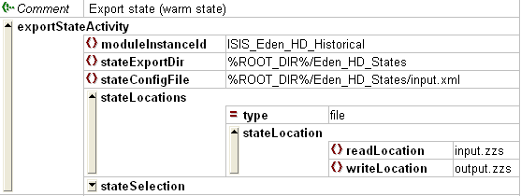
Exporting States
Defining “how” to export state
moduleInstanceId
stateExportDir
stateConfigFile
stateLocations
read
write
From the perspective
of the model!!

Slide 13
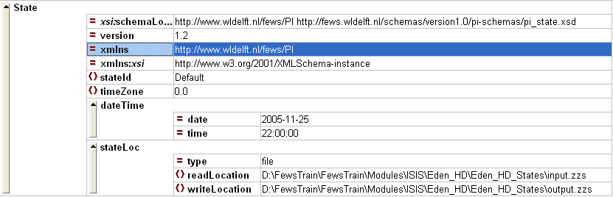
Exporting States
stateConfigFile
For export: Written by DELFT-FEWS ; read by adapter
For import:Written by adapter ; read by DELFT-FEWS

Slide 14
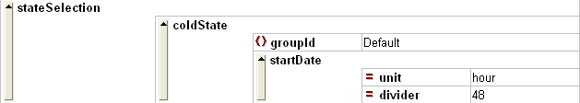
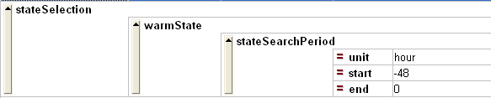
Exporting States
Defining “what” to state export; stateSelection
State selection determines length of module run!!!!!
Cold State: Always use a cold state to initiate module run
Warm State: Use most suitable/recent state in search period

Slide 15
States
State Search period
04:00
16:00
02:00
04:00
07:00
16:00
19:00
02:00
04:00
07:00
Start 02:00 Jan 05. T0 16:00 04 Jan
Start 7:30 and T0 07:00 Jan 05
Start 19:30 and T0 19:00 Jan 05
Start 02:00 Jan 06. T0 16:00 05 Jan
Start 07:30 and T0 07:00 Jan 06

Slide 16
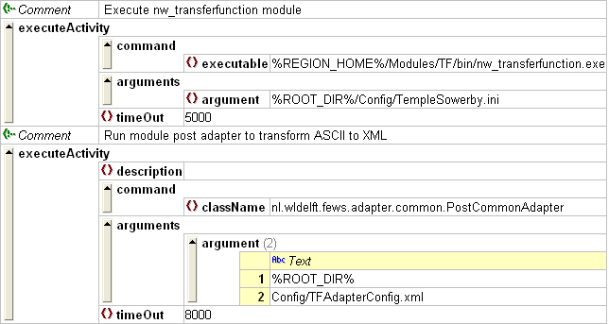
General Adapter – Execute Activities
Running modules
Executables or Java classes
Arguments can be passed
Timout is set in case module “hangs”
If Diagnostic file indicates error – or non zero return code
Executable considered to have failed

Slide 17
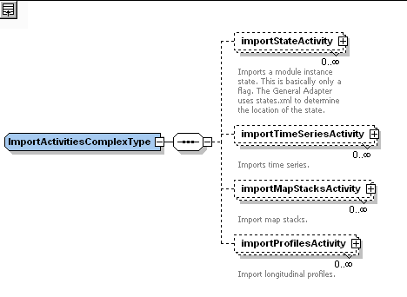
General Adapter – Import Activities
Import Time Series
Scalar
Longitudinal
Grid
Import States

Slide 18
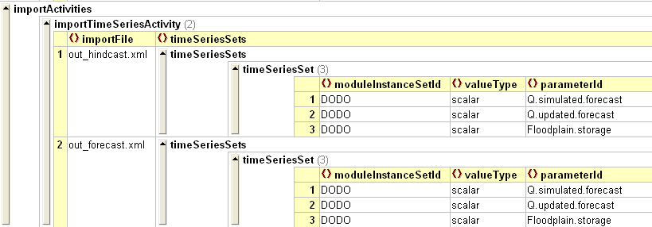
General Adapter – Import Activities
Importing time series
Same principle as exporting
File name & Time Series Set to save data to
IdMapping used to translate locationId’s and parameterId’s
Grids imported as mapstack + XML file

Slide 19

General Adapter – Import Activities
Importing states
Simple instruction where to find stateConfigFile

Slide 20
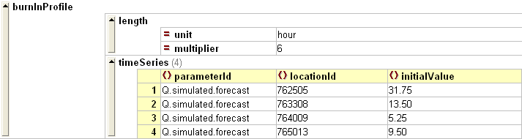
Burn-in profiles
Avoid “abrupt” shock to model on startup
Mainly relevant to HD modules (stability)
Only applied when starting from a cold state
Identify start value in cold state
Gradual “climb” to actual value

Slide 21
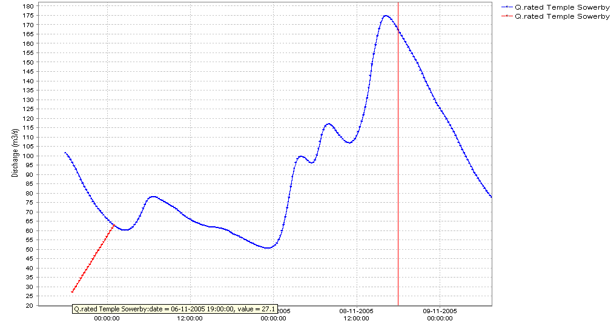
Burn-in profiles
Burn-in at Temple Sowerby

Slide 22
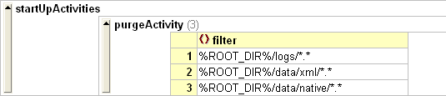
Startup/Shutdown activities
Clean up files from module
Startup – before running module
Shutdown – after completing module

Slide 23
Module diagnostics/debugging
PI-XML includes module diagnostics exchange
To be written by module/adapter
General Adapter Defines where diagnostics file is expected
Not all logging passed – use native module log files
External module log inserted into FEWS log
Most messages DEBUG level
Error/Fatal: System messages
Detecting module failure
Error in diagnostics log
non-zero return code

Slide 24
Using Module Configuration
Templates

Slide 25
Module Configuration Templates
Purpose:
- Allows for multiple instances of the same process for various modules using a single General Adapter configuration
- Reduces configuration effort
- Increases consistency
For example:
You want to run a Delft3D Flow simulation for two models
- Use moduleInstanceID: D3D_flow_1h_hc
- Use workflow: D3D_flow_model1 & D3D_flow_model2

Slide 26
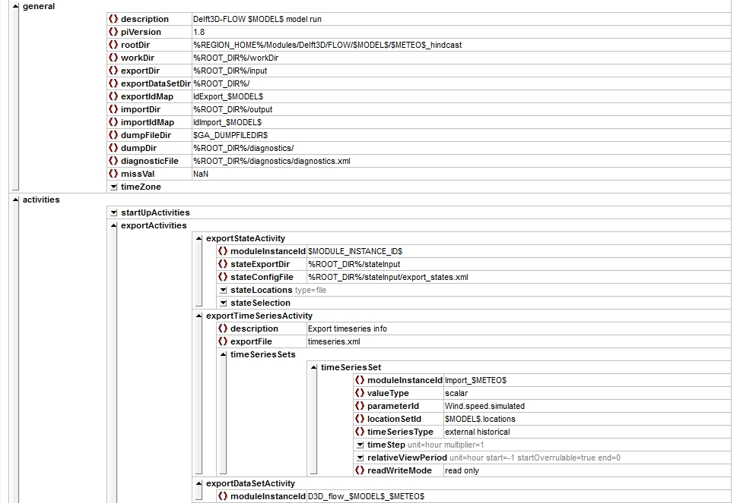
Module General Adapter template
Templates are made unique using keywords defined in the workflow
Text between $__$ is a user-defined keyword

Slide 27
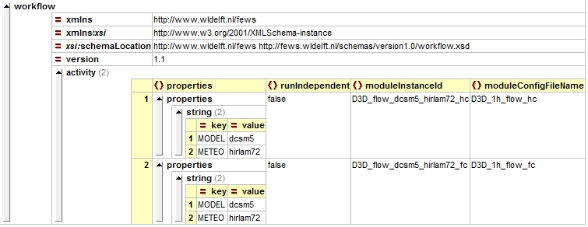
Workflow file
Keywords are passed to the General Adapter from the Workflow as properties
Template configuration file!
$MODEL$ = dcsm5
$METEO$ = hirlam72
D3D_flow_$MODEL$_$METEO$ = D3D_flow_dcsm5_hirlam72

Slide 28
Quick guide and wiki for model adapters
https://publicwiki.deltares.nl/display/FEWSDOC/Quick-start+Guide+for+Adding+an+External+Module+in+FEWS
https://publicwiki.deltares.nl/display/FEWSDOC/Model+adapters

Slide 29
General Adaptor - Exercise
Exercise 12: Add an external module

